Slide 1

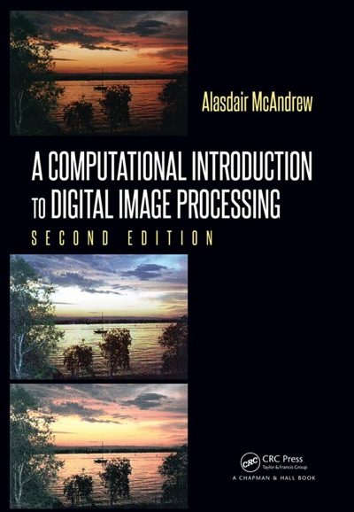
Chapter 6
Image Geometry

Slide 2

Image Processing Operations
6.1 Interpolation of Data
6.2 Image Interpolation
6.3 General Interpolation
6.4 Enlargement by Spatial Filtering
6.5 Scaling Smaller
6.6 Rotation
6.7 Correcting Image Distortion

Slide 3
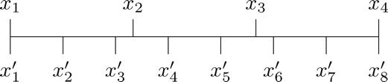
Interpolation of Data
Simple Problem
Have 4 values
Want to enlarge to 8
Figure 6.1: Replacing four points with eight

Slide 4
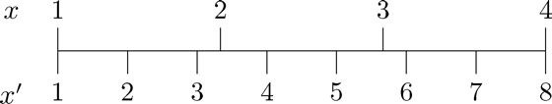
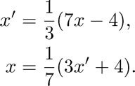
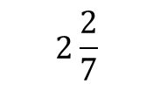
Interpolation of Data
Figure 6.2: Figure 6.1 slightly redrawn
Suppose that the distance between each of the x_{i} points is 1; thus, the length of the line is 3. Thus, since there are seven increments x₁ from to x₈, the distance between each two will be 3/7 ≈ 0.4286.
Formulas can be derived from finding eq. of a line given 2 points (4, 8) & (1, 1) going from x to x'; (8, 4) & (1, 1) going from x' to x
What value for x do you get if you plug in 4 for x'?
$$2\frac{2}{7}$$

Slide 5
Interpolation of Data
Figure 6.2: Figure 6.1 slightly redrawn
MatLab/Octave:
linspace(X1, X2, N) generates N points between X1 and X2.
For N = 1, linspace returns X2.
>> x2 = linspace(1,4,8)
x2 =
1.0000 1.4286 1.8571 2.2857 2.7143 3.1429 3.5714 4.0000

Slide 6
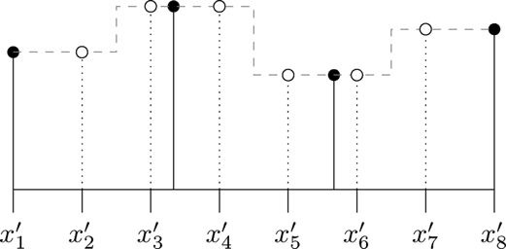

Nearest Neighbor Interpolation
Interpolation: guessing at function
Nearest neighbor interpolation: assign $f\left(x_{i}^{′}\right)=f(x_{j})$where $x_{j}$is the original point closest to $x_{i}^{′}$
Figure 6.3: Nearest neighbor interpolation
Closed circles =
original values
Open circles = interpolated values

Slide 7
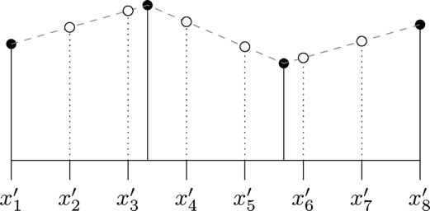
Linear Interpolation
Linear interpolation: join the original function values by straight lines, and take interpolated values as the values at those lines.
Figure 6.4: Linear interpolation

Slide 8
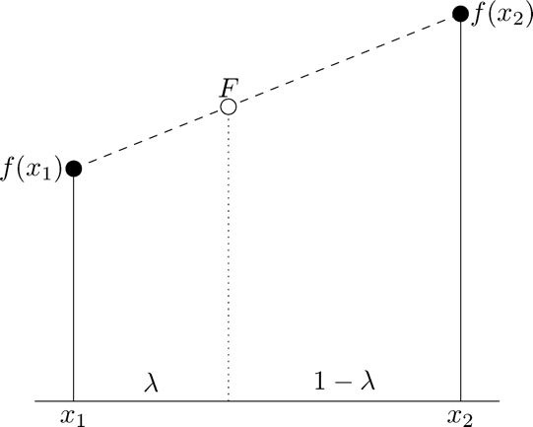

Linear Interpolation
To calculate values
By considering slopes: $\frac{F−f(x_{1})}{λ}=\frac{f\left(x_{2}\right)−f(x_{1})}{1}$
Solve for F: $F=λf\left(x_{2}\right)+\left(1−λ\right)f(x_{1})$
m₁
m₂
m₂
m₁

Slide 9
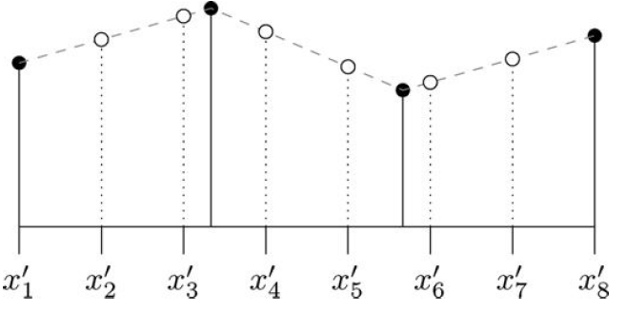
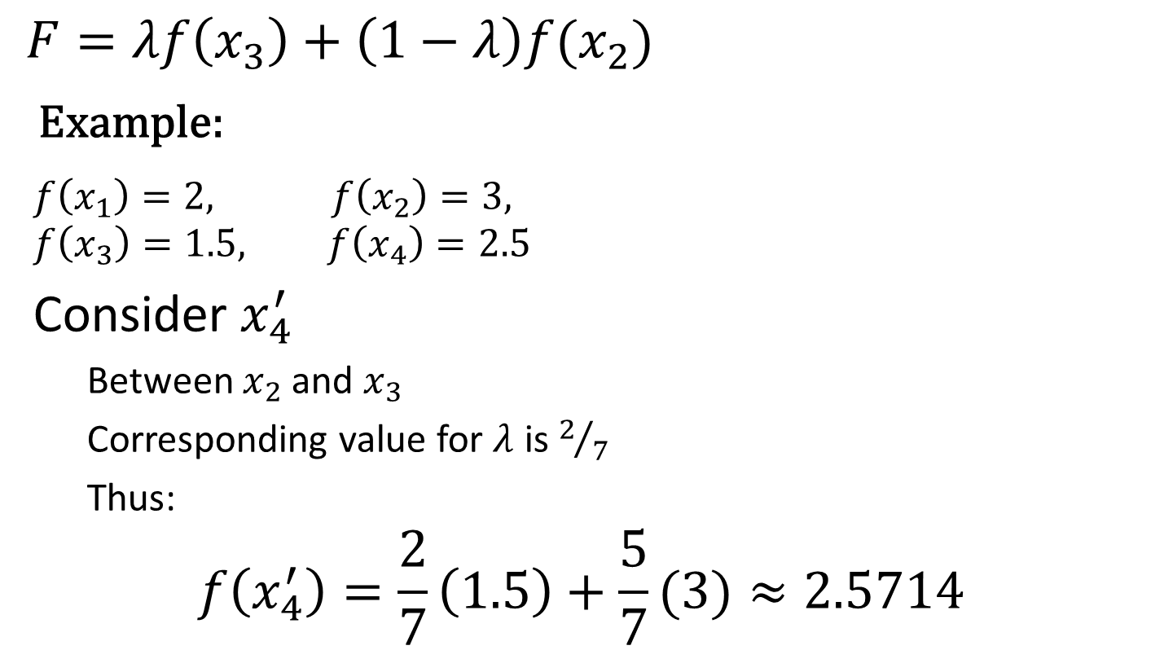
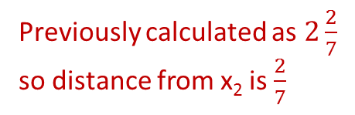
Linear Interpolation
$$F=λf\left(x_{3}\right)+\left(1−λ\right)f(x_{2})$$
Example:
$$f\left(x_{1}\right)=2, f\left(x_{2}\right)=3,$$
$$f\left(x_{3}\right)=1.5, f\left(x_{4}\right)=2.5$$
Consider $x_{4}^{′}$
Between $x_{2}$ and $x_{3}$
Corresponding value for $λ$ is $2/7$
Thus:
$$f\left(x_{4}^{′}\right)=\frac{2}{7}\left(1.5\right)+\frac{5}{7}(3)≈2.5714$$
Value to calculate
x₁
x₂
x₃
x₄
Previously calculated as $2\frac{2}{7}$ so distance from x₂ is $\frac{2}{7}$

Slide 10
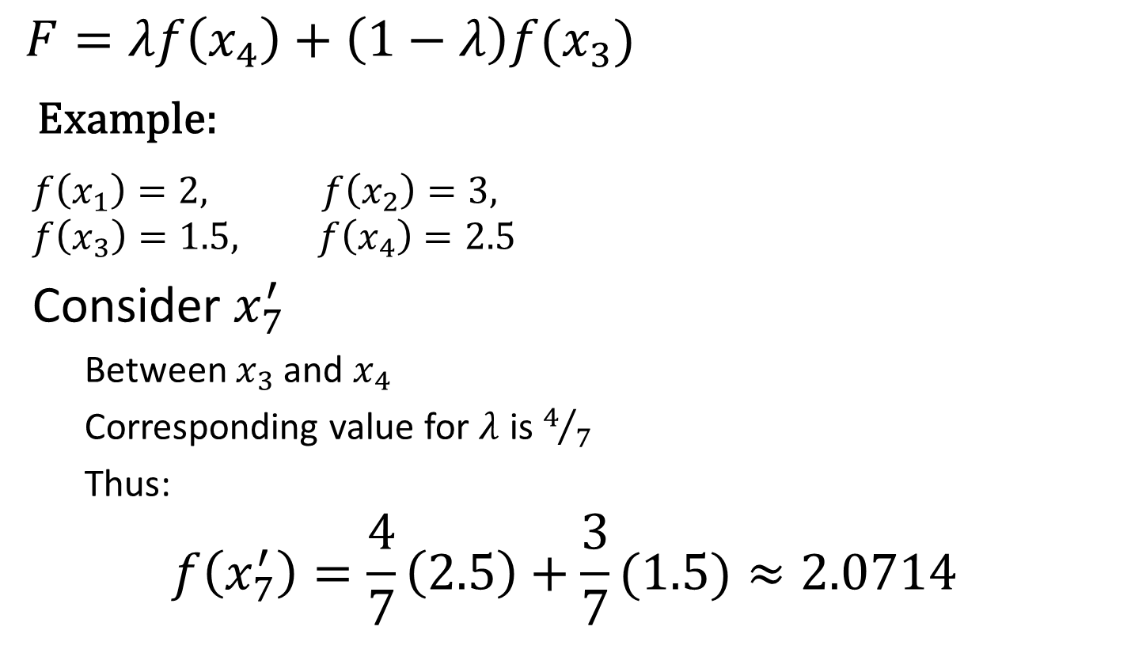

Linear Interpolation
$$F=λf\left(x_{4}\right)+\left(1−λ\right)f(x_{3})$$
Example:
$$f\left(x_{1}\right)=2, f\left(x_{2}\right)=3,$$
$$f\left(x_{3}\right)=1.5, f\left(x_{4}\right)=2.5$$
Consider $x_{7}^{′}$
Between $x_{3}$ and $x_{4}$
Corresponding value for $λ$ is $4/7$
Thus:
$$f\left(x_{7}^{′}\right)=\frac{4}{7}\left(2.5\right)+\frac{3}{7}(1.5)≈2.0714$$
Value to calculate
x₁
x₂
x₃
x₄
Previously calculated as $3\frac{4}{7}$ so distance from x₃ is $\frac{4}{7}$

Slide 11
Interpolation Example
MatLab/Octave Example:
>> orig = [3 5 8 4 2];
>> sp = linspace(1,5,7)
sp =
1.0000 1.6667 2.3333 3.0000 3.6667 4.3333 5.0000
>> new = uint8(interp1(orig, sp, 'nearest'))
new =
3 5 5 8 4 4 2
>> new = uint8(interp1(orig, sp, 'linear'))
new =
3 4 6 8 5 3 2
Nearest: Notice that all numbers are the same as original, but spread out so there are 7 instead of 5.
Linear: Notice that the 7 numbers are NOT all the same as original 5.

Slide 12
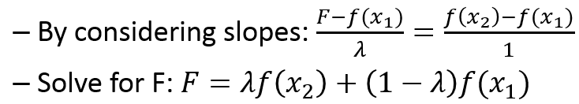

Interpolation Example
MatLab/Octave Example:
>> orig = [3 5 8 4 2];
>> sp = linspace(1,5,7)
sp =
1.0000 1.6667 2.3333 3.0000 3.6667 4.3333 5.0000
>> new = uint8(interp1(orig, sp, 'linear'))
new =
3 4 6 8 5 3 2
1 2 3 4 5
8
5
m₁
$$=round(.3333∗8+\left(1−.3333\right)∗5)$$
.3333
1 – 0.3333
x₁
x₂

Slide 13
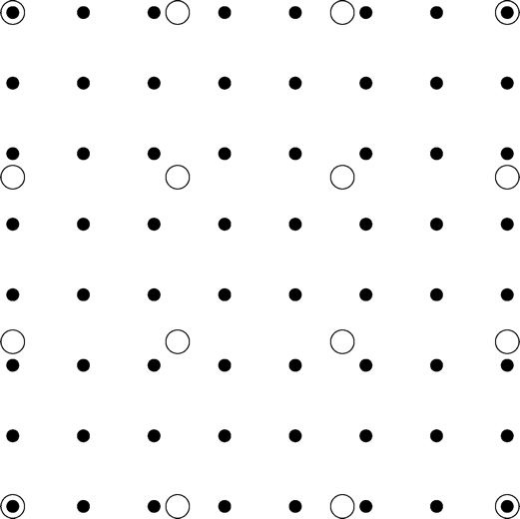
Image Interpolation
Figure 6.6: Interpolation on an image: Large open circles are original points, filled circles are interpolated

Slide 14
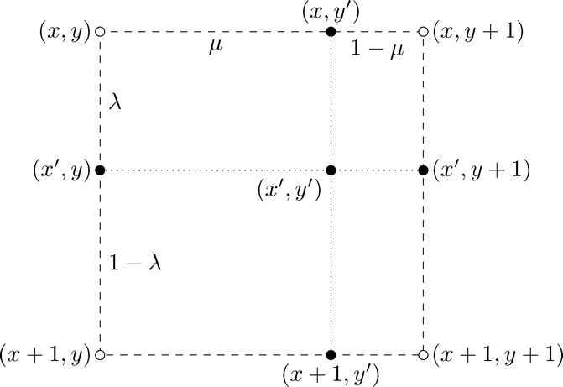
Image Interpolation
Figure 6.7: Interpolation between four image points

Slide 15
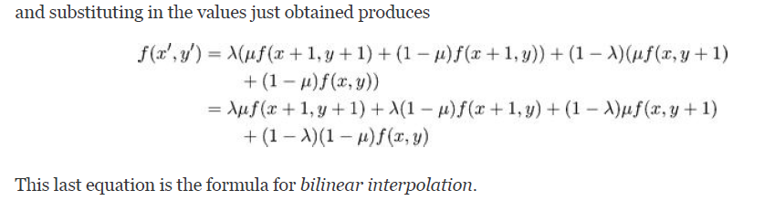
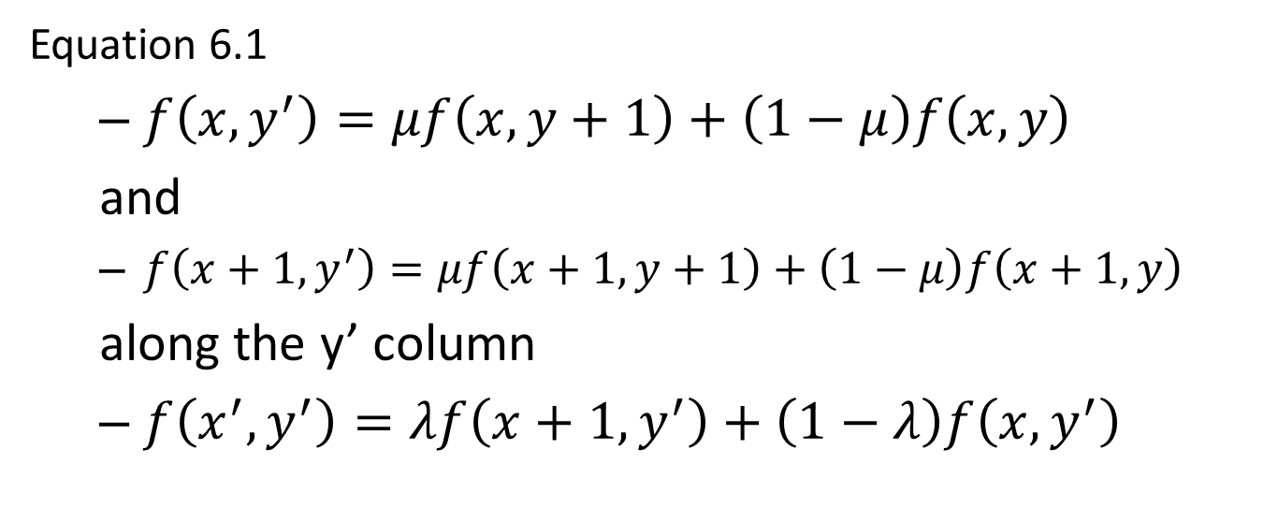
Image Interpolation
Equation 6.1
$f\left(x, y^{′}\right)=μf\left(x,y+1\right)+\left(1−μ\right)f\left(x,y\right)$
and
$f\left(x+1, y^{′}\right)=μf\left(x+1, y+1\right)+\left(1−μ\right)f\left(x+1, y\right)$
along the y’ column
$f\left(x^{′}, y^{′}\right)=λf\left(x+1, y^{′}\right)+\left(1−λ\right)f\left(x, y^{′}\right)$

Slide 16
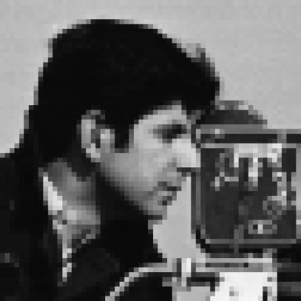

Image Interpolation
Nearest neighbor gives blocky effect…YUCK!
Bilinear interpolation is smoother…but blurry
Interpolation CAN’T predict values
CAN’T create something from NOTHING!

Slide 17
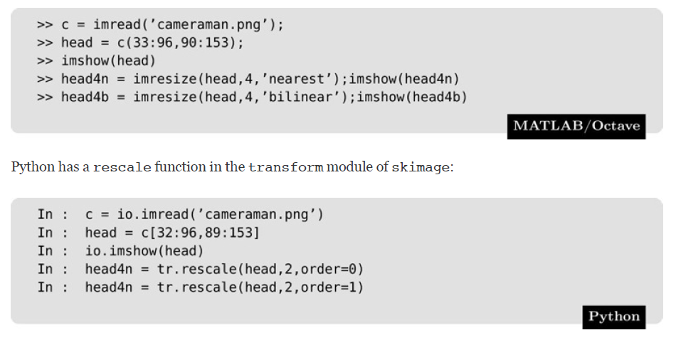
Try It:
#order=0, nearest neighbor
#order=1, bilinear interpolation

Slide 18
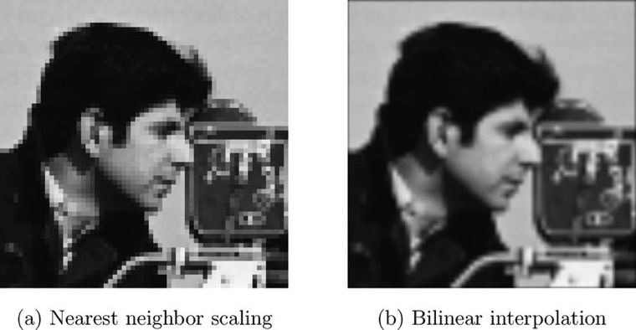
General Interpolation
Figure 6.9: Scaling by interpolation

Slide 19

General Approach
Nearest neighbor and bilinear interpolation are two special cases of a more general approach.
The idea is this: we wish to interpolate a value f(x') for x₁ ≤ x’ ≤ x₂, and suppose x’ − x₁ = λ. We define an interpolation function R(u), and set

Slide 20
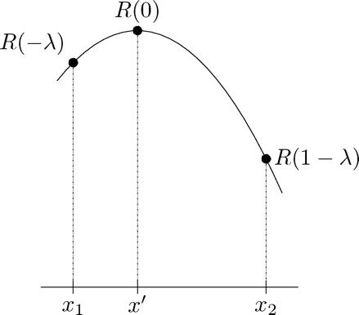
General Interpolation
Figure 6.10: Using a general interpolation function
The function R(u) is centered at x', so x1 corresponds with u = −λ, and x2 with u = 1 − λ.

Slide 21
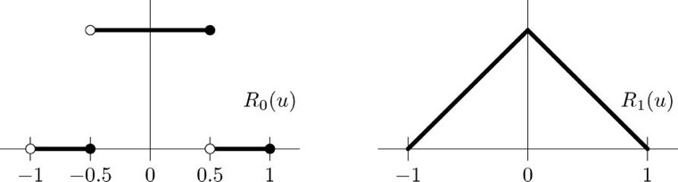
General Interpolation
Both these functions are defined on the interval −1 ≤ u ≤ 1 only.
Figure 6.11: Two interpolation functions

Slide 22


General Interpolation
Their formal definitions are:
and

Slide 23
General Interpolation
Consider Nearest Neighbor R(u):
To see this, consider the two cases λ < 0.5 and λ ≥ 0.5 separately.
If λ < 0.5, then R0(−λ) = 1 and R0(1 − λ) = 0. Then
If λ ≥ 0.5, then R0(−λ) = 0 and R0(1 − λ) = 1. Then
In each case f(x') is set to the function value of the point closest to x'.

Slide 24

General Interpolation
Similarly, substituting R₁(u) for R(u) in Eq. 6.2 will produce linear interpolation.
which is the correct equation for linear interpolation.

Slide 25

Cubic Interpolation
The functions R₀(u) and R₁(u) are just two members of a family of possible interpolation functions. Another such function provides cubic interpolation; its definition is:
Definition:

Slide 26
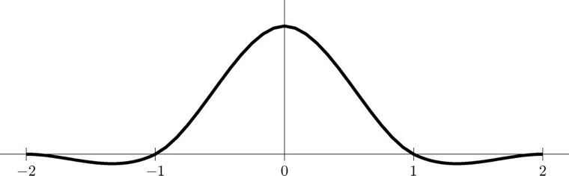
Cubic Interpolation
Definition:
Defined over the interval −2 ≤ u ≤ 2
Figure 6.12: The cubic interpolation function R3(u)

Slide 27
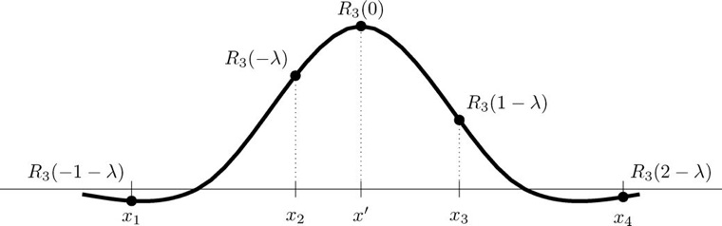
Cubic Interpolation
Cubic interpolation is slightly different from that of R₀(u) and R₁(u), in that as well as using the function values f(x₁) and f(x₂) for x₁ and x₂ on either side of x', we use values of x further away. In fact the formula we use, which extends Equation 6.2, is:
Figure 6.13: Using R₃(u) for interpolation

Slide 28
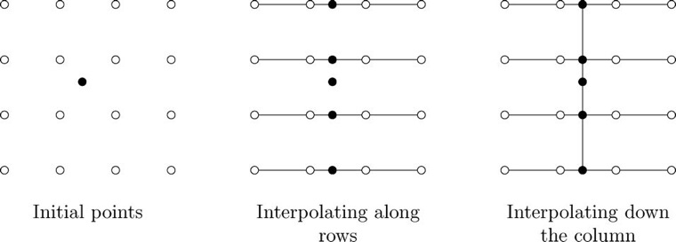
Bicubic Interpolation
To apply this interpolation to images, we use the 16 known values around our point (x', y'). First interpolate along the rows, and then finally down the columns,
Figure 6.14: How to apply bicubic interpolation

Slide 29
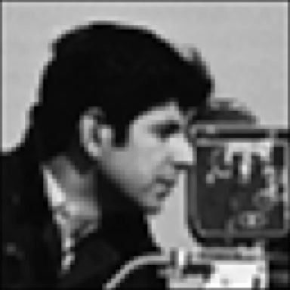
Bicubic Interpolation
Figure 6.15: Enlargement using bicubic interpolation

Slide 30
Spatial Filtering
Want to enlarge image by power of 2?
Use linear filtering on matrix
Create zero-interleaved version
Apply a spatial filter to the matrix
Implements nearest neighbor and bilinear interpolation

Slide 31
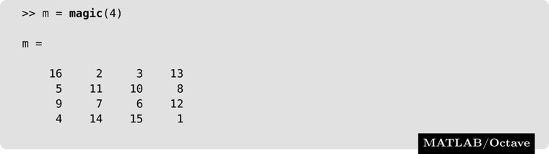
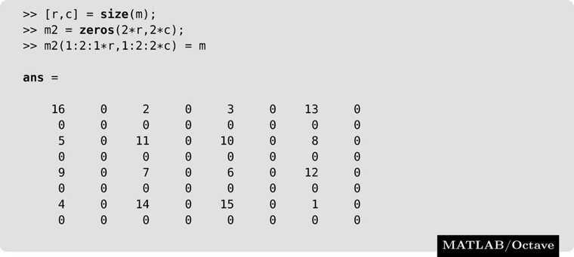
Spatial Filtering
Typo in book. Third line should be:
m2(1:2:2*r, 1:2:2*c) = m

Slide 32

Spatial Filtering
We can now replace the zeros by applying a spatial filter to this matrix.
Nearest Neighbor
Bilinear Interpolation
Typo in book. Third line should be:
m2(1:2:2*r, 1:2:2*c) = m

Slide 33

Spatial Filtering
Bicubic Interpolation
Typo in book. Third line should be:
m2(1:2:2*r, 1:2:2*c) = m

Slide 34
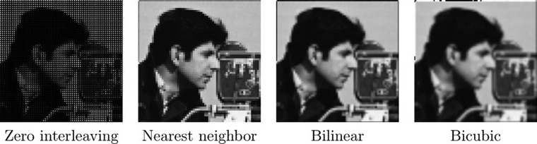
Spatial Filtering
Figure 6.16: Enlargement by spatial filtering

Slide 35
Scaling Smaller
Image minimization: making an image smaller
How?
Subsampling: taking out alternate pixels
Can create gaps
Apply a low pass filter first

Slide 36
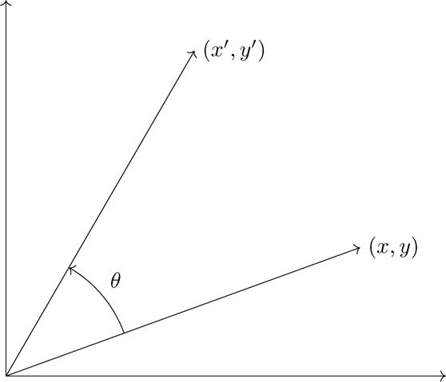

Rotation
Figure 6.18: Rotating a point through angle θ

Slide 37
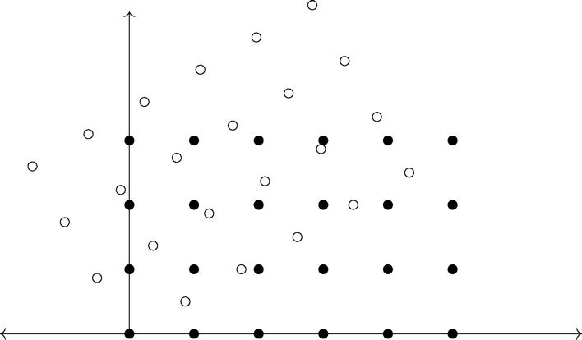
Rotation
Figure 6.19: Rotating a rectangle

Slide 38
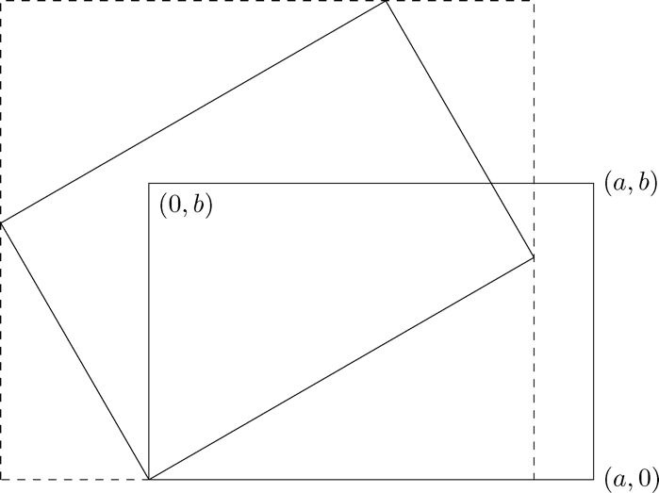
Rotation
Figure 6.20: A rectangle surrounding a rotated image

Slide 39
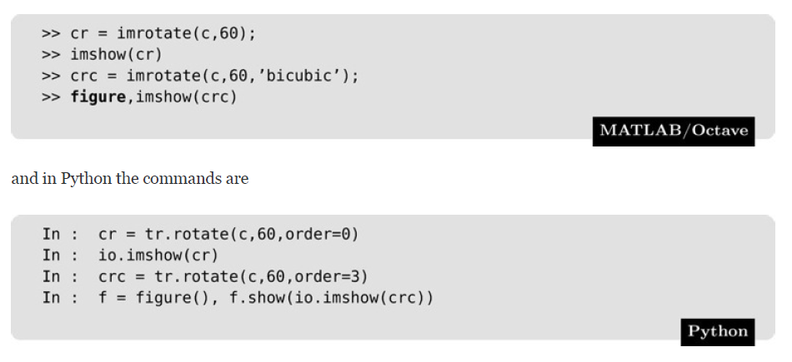
Try It: c = imread('cameraman.png')
% default is nearest neighbor

Slide 40
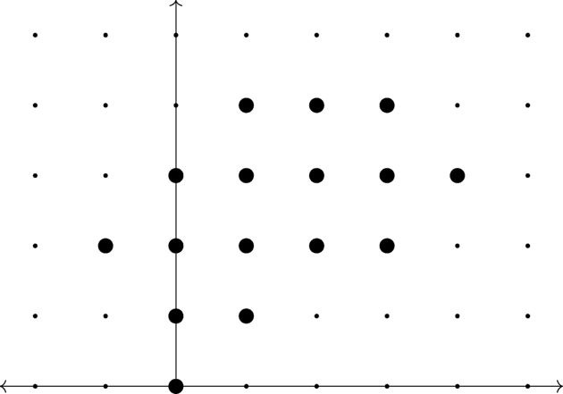
Rotation
Figure 6.21: The points on a grid after rotation

Slide 41
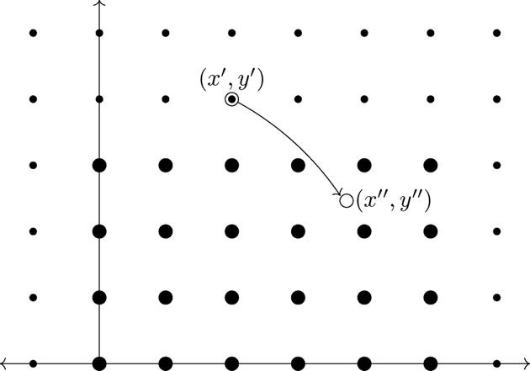
Rotation
Figure 6.22: Rotating a point back into the original image

Slide 42
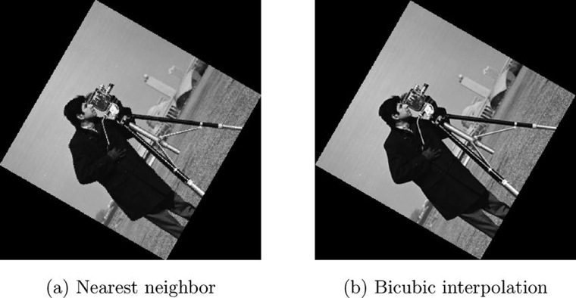
Rotation
Figure 6.23: Rotation with interpolation

Slide 43
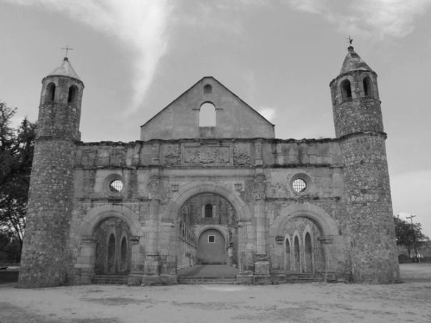
Correcting Image Distortion
Perspective Distortion:
Because of the position of the camera lens relative to the building, the towers appear to be leaning inward.
Fixing this requires a little algebra.
Figure 6.24: Perspective distortion

Slide 44
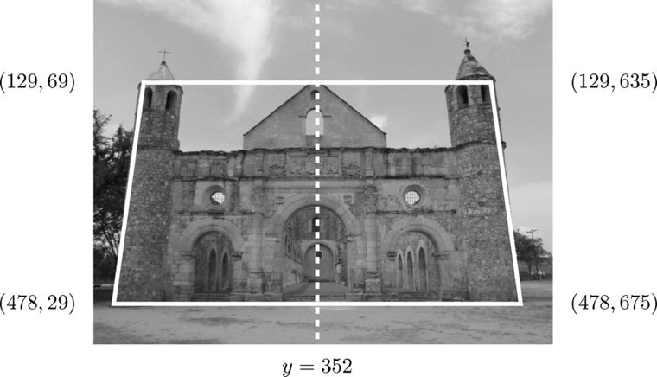
Correcting Image Distortion
Figure 6.25: The corners of the building

Slide 45
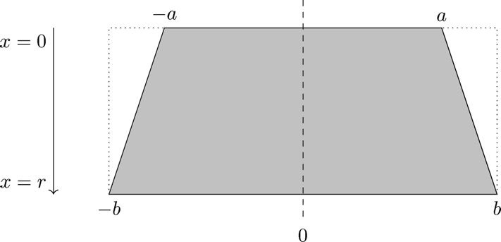
Correcting Image Distortion
Figure 6.26: A general symmetric trapezoid

Slide 46

Correcting Image Distortion
Stretching amount is linear function of x, thus:
If (x1, y1) and (x2, y2) are points, then equation is:

Slide 47
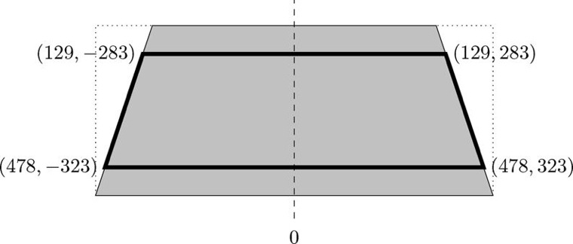
Correcting Image Distortion
Figure 6.27: The trapezoid around the building

Slide 48
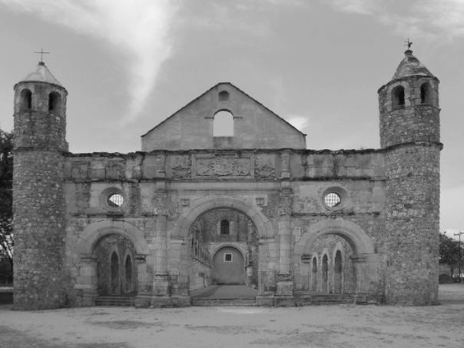
Correcting Image Distortion
Figure 6.28: The image corrected for perspective distortion

Slide 49
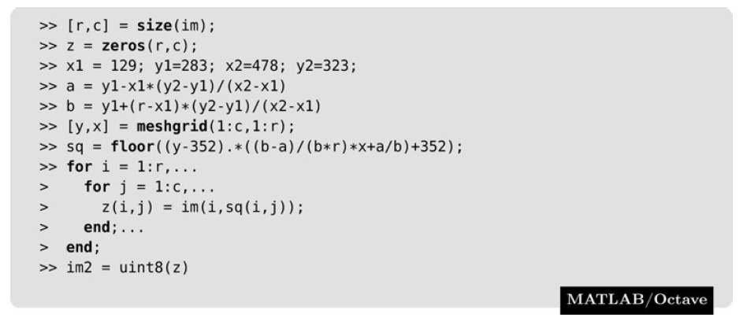
im = imread('monastery.png');

Slide 50
